Slide 1
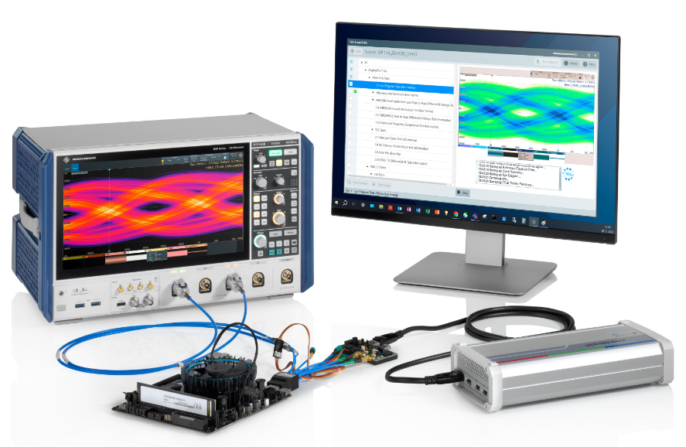
Testing DP 1.4a / eDP 1.5 Sources
With Oscilloscopes
PHY Layer Compliance
Webinar
Guido Schulze, Product Manager Oscilloscopes
Alessandro Cappelletti, Application Engineer Oscilloscopes

Slide 2


Outline
Testing DP / eDP Interfaces
Technology Refresher
Compliance Testing
R&S Test Solutions
Demonstration
Summary

Slide 3
DisplayPort –Technology Refresher

Slide 4


What is DisplayPort
Technology Refresher
Digital Display Interface
Typically used for gaming or similar consumer electronics
DisplayPort created in 2006 by VESA
Competes with HDMI as a video standard
There are lots of versions of DisplayPort:
  embedded DP / Alt Mode / Dual-Mode DP / internal DP / wireless DP
Popular in different applications and industries
  e.g. automotive, aerospace & defense, medical, etc.
Notes:
It’s the industry replacement for outmoded display technologies such as DVI, LVDS and VGA and it’s currently being built into all new PC chipsets, GPU’s and display controllers from major silicon manufacturers.
First standard to support 8K resolution (7680 x 4320) at 60 Hz refresh rate
delivering a maximum payload of 77.37 Gbps
Automotive (Continental, Bosch, MegaChips)
Medical (GE, Philips, Stryker, Siemens)
Defense (Lockheed Martin, L3Harris, Leidos)
Traditional High Speed Digital customers (Apple, Nvidia, AMD, Microsoft, TI, STMicro, etc.)

Slide 5
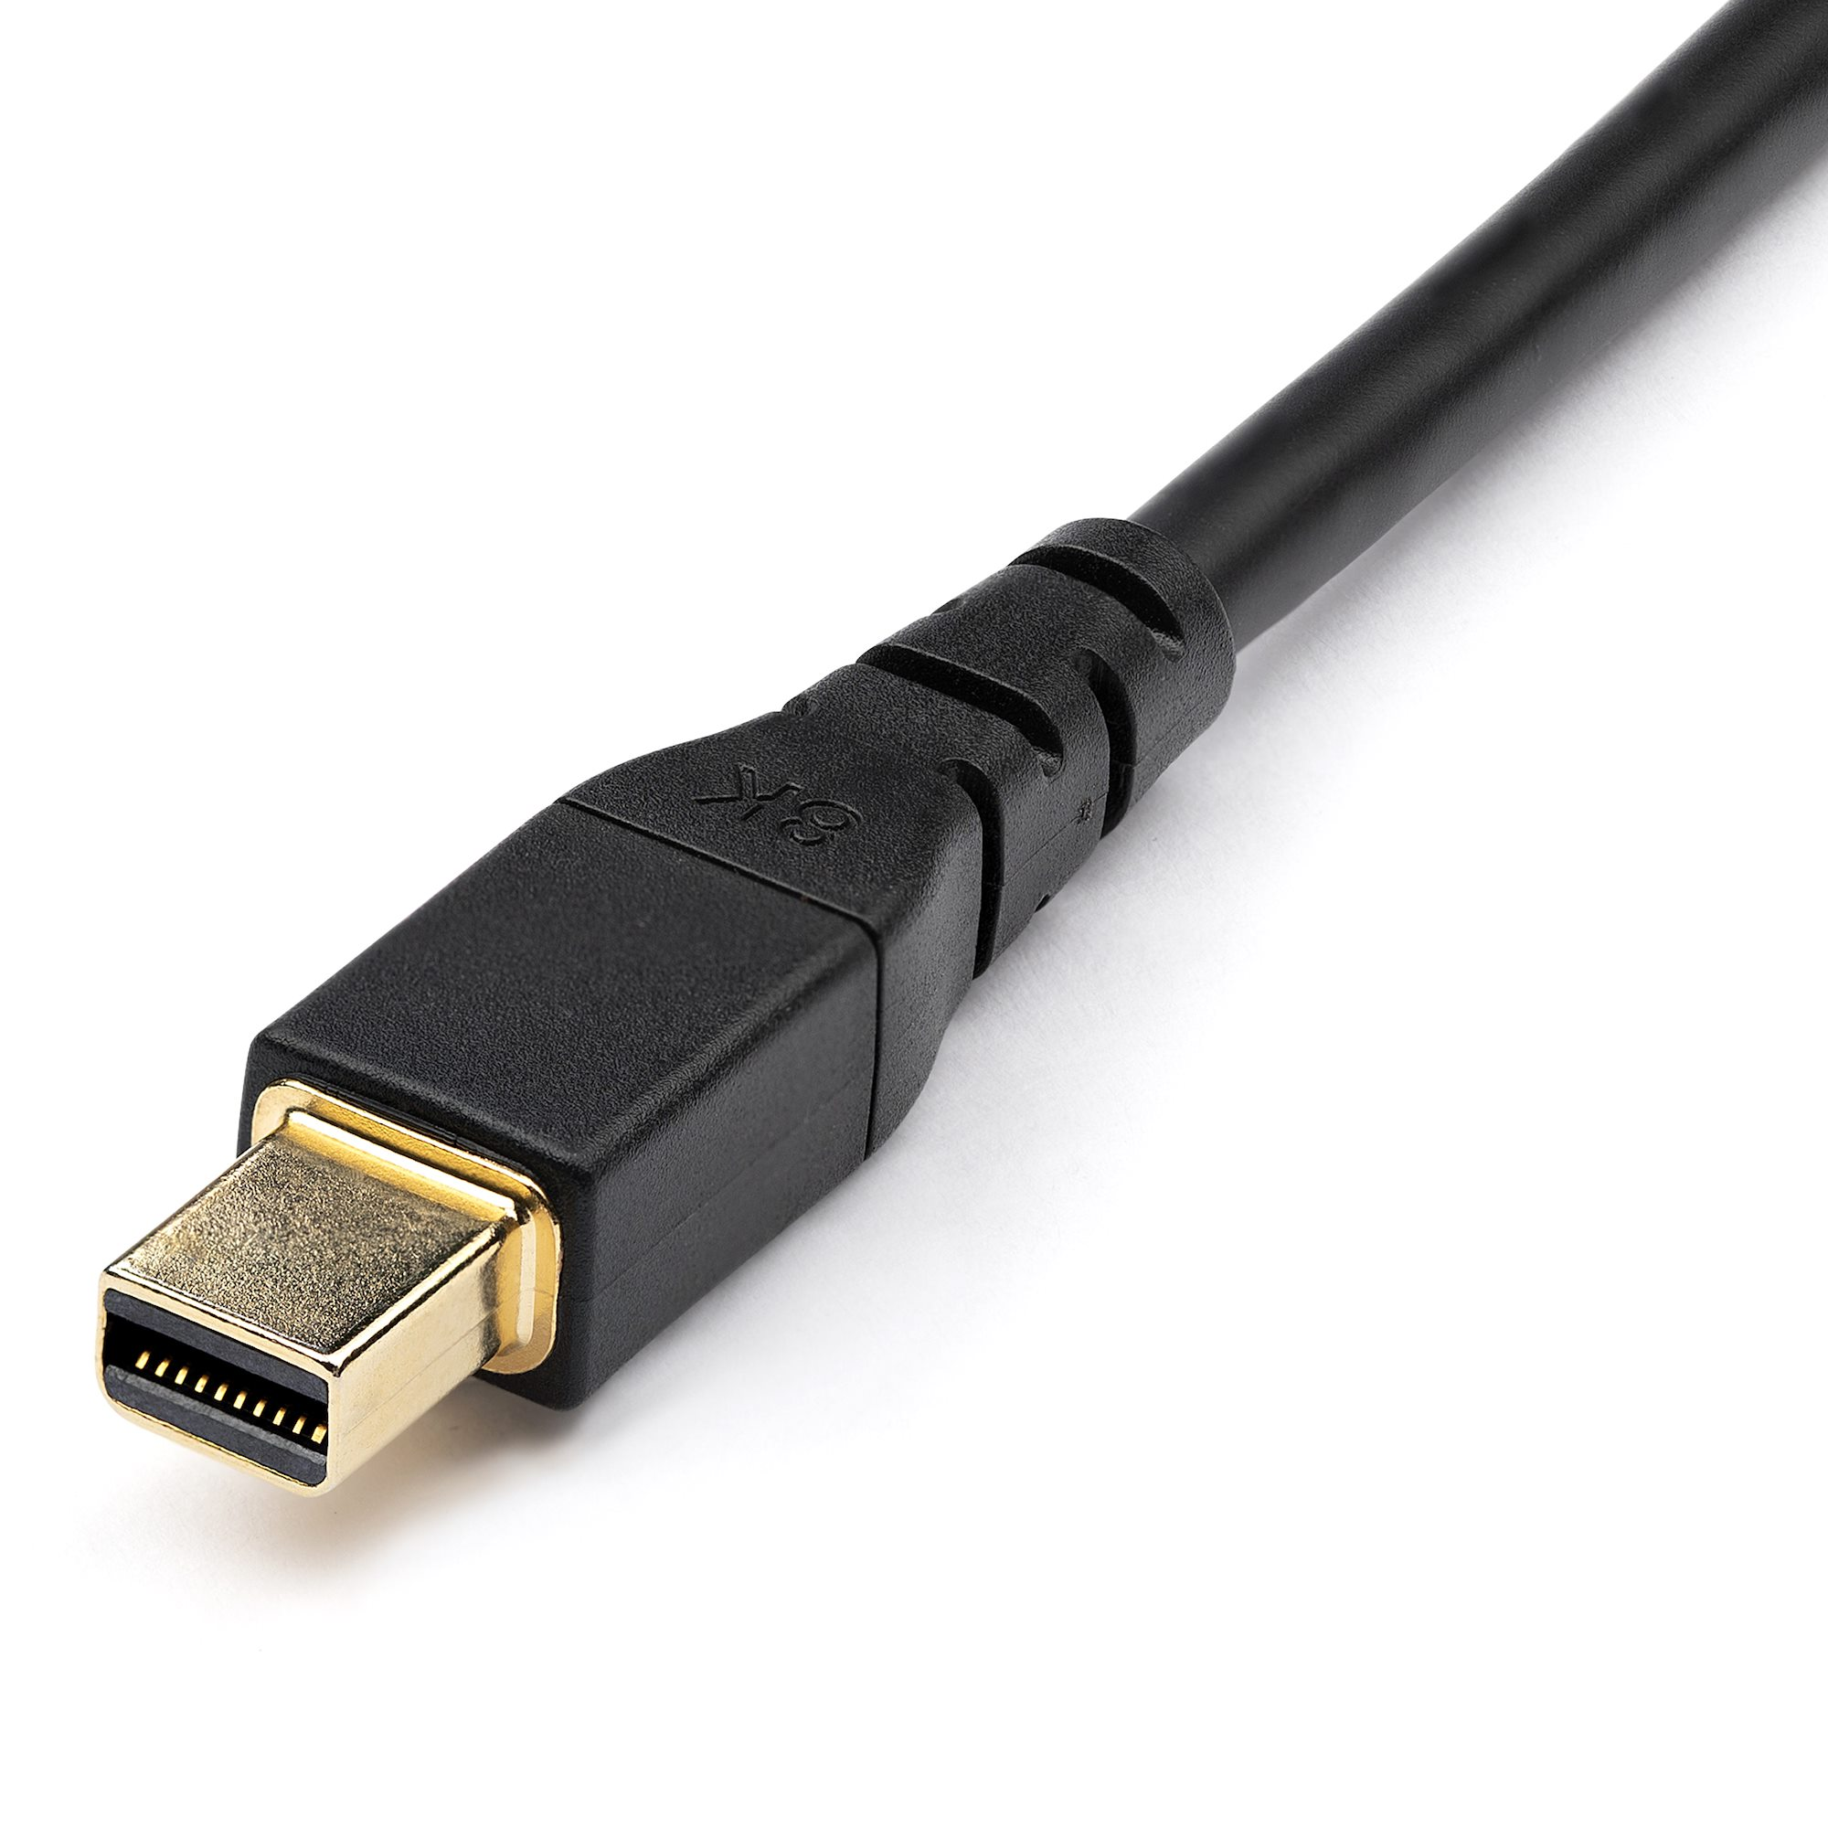
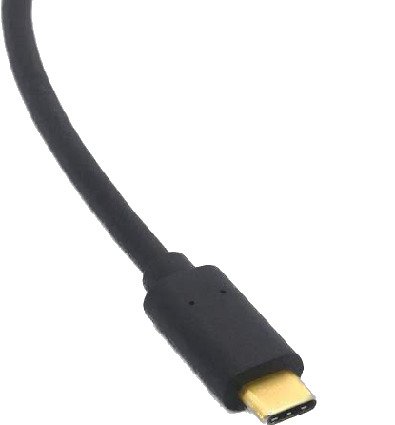
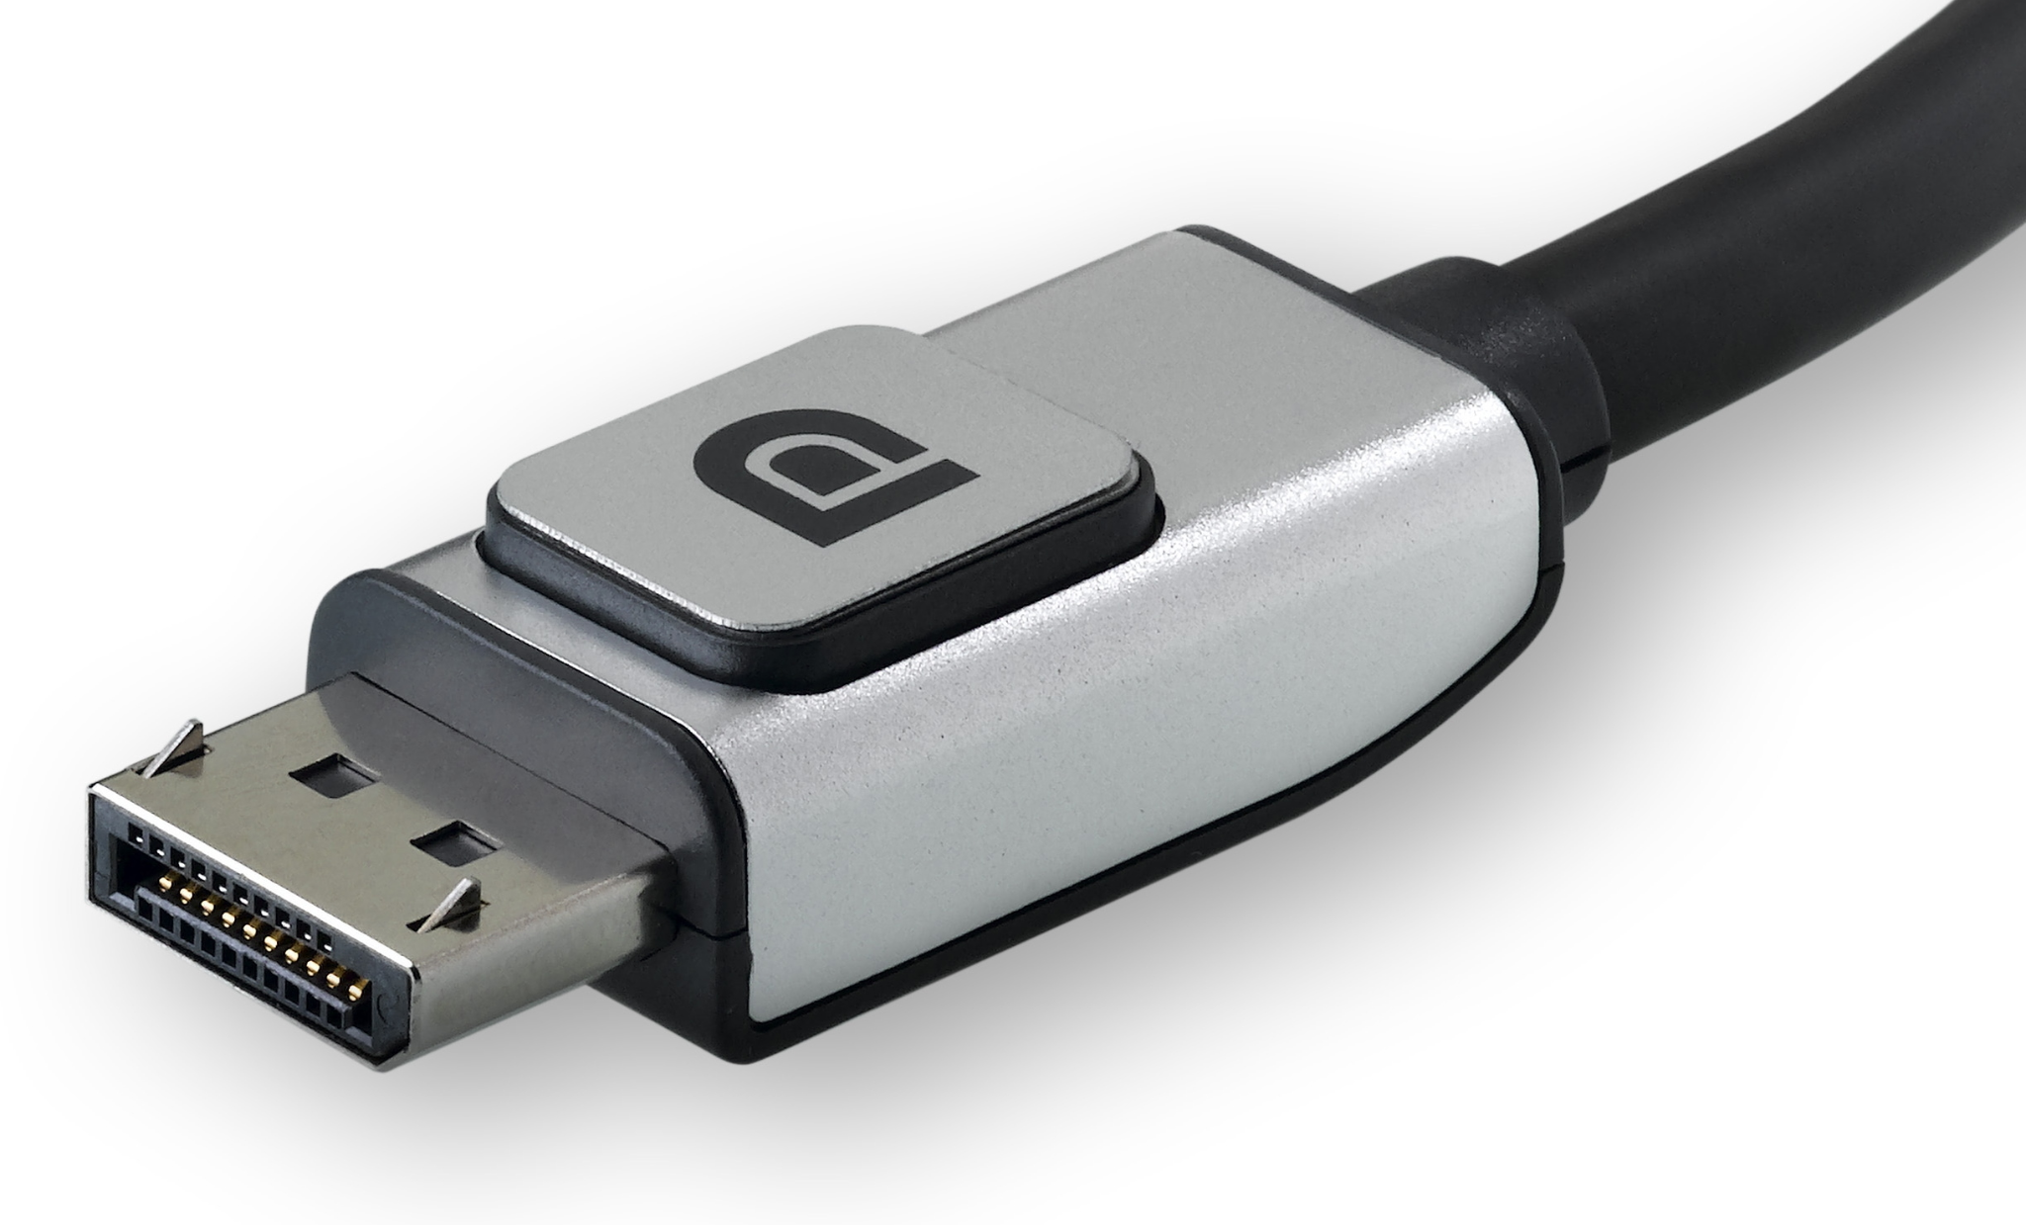
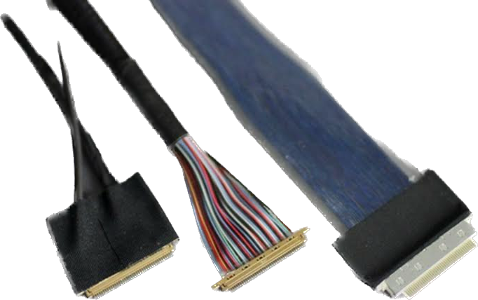
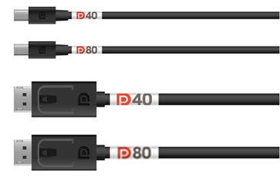
Connector Types
Technology Refresher
Mini DP
Full size DP
USB Type-C
Embedded DP
Enhanced Full size DP and Mini DP
Source: https://vesa.org/
Notes:
Enhanced DP connectors support new DP v2.1’s DP40 and DP80 high-speed modes
uses the same form factor as the regular Full Size DP and mini DP structure, internally in the connector there is a difference. There is a paddle card in the connector as well as more shielding and a different pin layout.

Slide 6
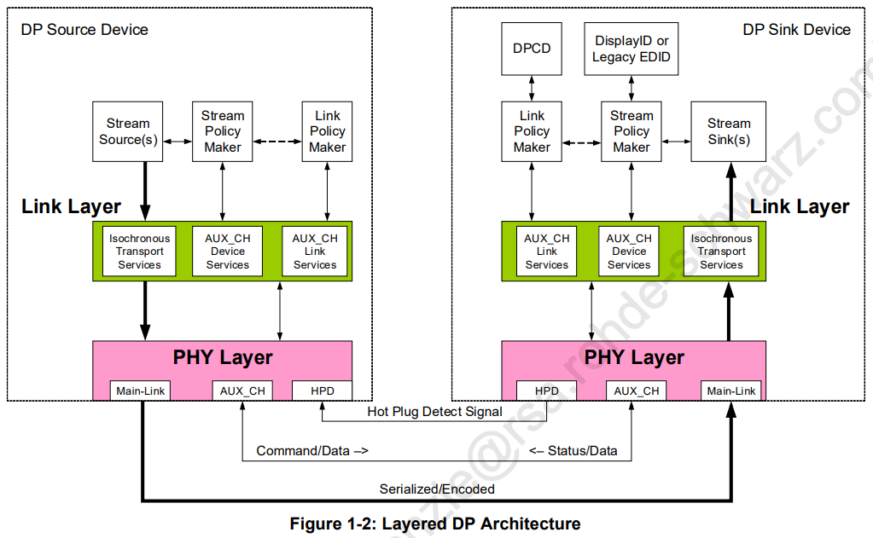
DisplayPort Architecture
Technology Refresher
Source: DP Standard, Version 1.4a (Vesa.org)
Notes:
Notice how the main link only goes source to sink, there are channels that go back and forth but these are communication lanes that do not carry much data

Slide 7
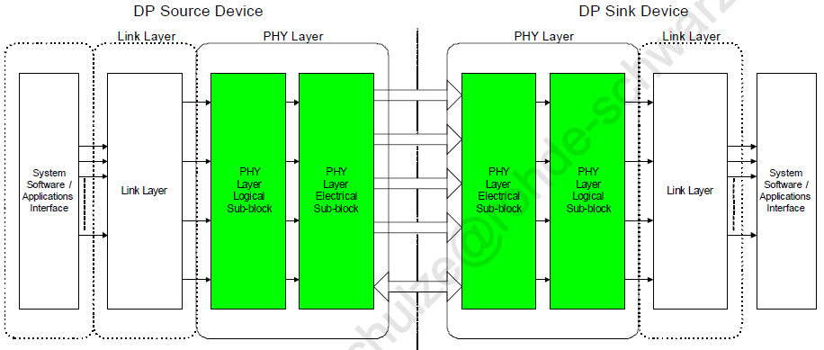
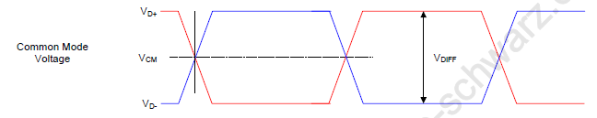
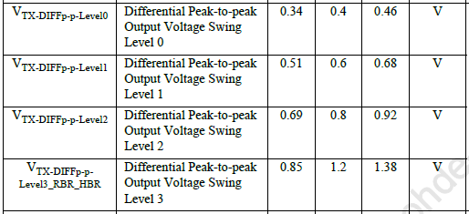
Signaling – Main Link
DP 1.4a / eDP 1.5
Technology Refresher
4 high-speed lanes (main link)
  Uni-directional
  Serial interface w/ embedded clock
  2nd order PLL CDR
  Scrambling; 8B/10B coding
  TX: Preemphasis
  RX: 1st order CTLE + 1-tap DFE equalizer (HBR3)
Source: DP Standard, Version 1.4a (Vesa.org)
Notes:
Scrambling of the Main-Link data is performed for EMI reduction prior to 8b/10b encoding on the transmitter. De-scrambling of the data symbols is performed following 8b/10b decoding at the receiver. Use of scrambling should result in approximately 7dB reduction in peak spectrum.
Logical Sub-block
• Scrambling and de-scrambling
• 8b/10b encoding/decoding
• Serialization and de-serialization
• Link Training and Link Status Monitor
• Adjusts link rate, spreading, drive current level, and pre-emphasis level, as needed
• Link Quality Measurement for testability
Electrical Sub-block
• Consists of up to four differential pairs
• Transmitter
• Drives doubly terminated, AC-coupled differential pairs in a manner compliant with
the Main-Link Transmitter electrical specification
• Receiver
• Receives the incoming differential signals and extract the data with its link CDR (clock
and data recovery) circuits
• HBR3: CTLE w/ multiple DC gains + 1-tap DFE
• HBR/HBR2: CTLE w/ different HF boost

Slide 8
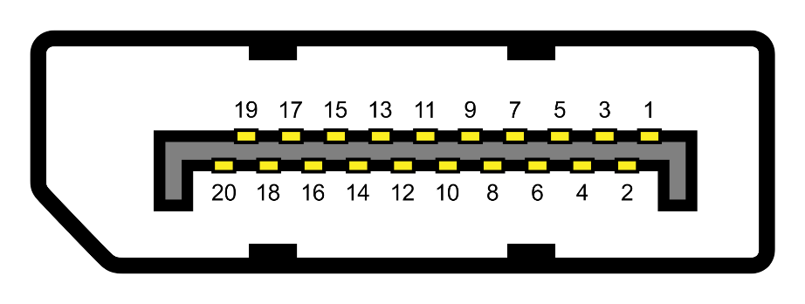
Pin Out of the Full-Size connector
Technology Refresher
Pin 1 Lane 0 (+)
Pin 2 Ground
Pin 3 Lane 0 (−)
Pin 4 Lane 1 (+)
Pin 5 Ground
Pin 6 Lane 1 (−)
Pin 7 Lane 2 (+)
Pin 8 Ground
Pin 9 Lane 2 (−)
Pin 10 Lane 3 (+)
Pin 11 Ground
Pin 12 Lane 3 (−)
Pin 13 Connected to ground[b]
Pin 14 Connected to ground[b]
Pin 15 Auxiliary channel (+)
Pin 16 Ground
Pin 17 Auxiliary channel (−)
Pin 18 Hot plug detect
Pin 19 Return for power
Pin 20 Power for connector
Notes:
Notice there are four data lanes, these are the lanes that carry the high speed signals that we are most interested in testing; The PHY Layer provides the unidirectional Main-Link for the transport of isochronous streams and secondary-data packets.
AUX channel: The AUX_CH is a half-duplex, bidirectional channel consisting of one differential pair; Link Configuration or Maintenance and DisplayID or legacy EDID access, using 1-Mbps Manchester-II coding.
Hot plug: Hot Plug/Unplug events
Power: upstream up to 3 V; downstream up to 18V

Slide 9
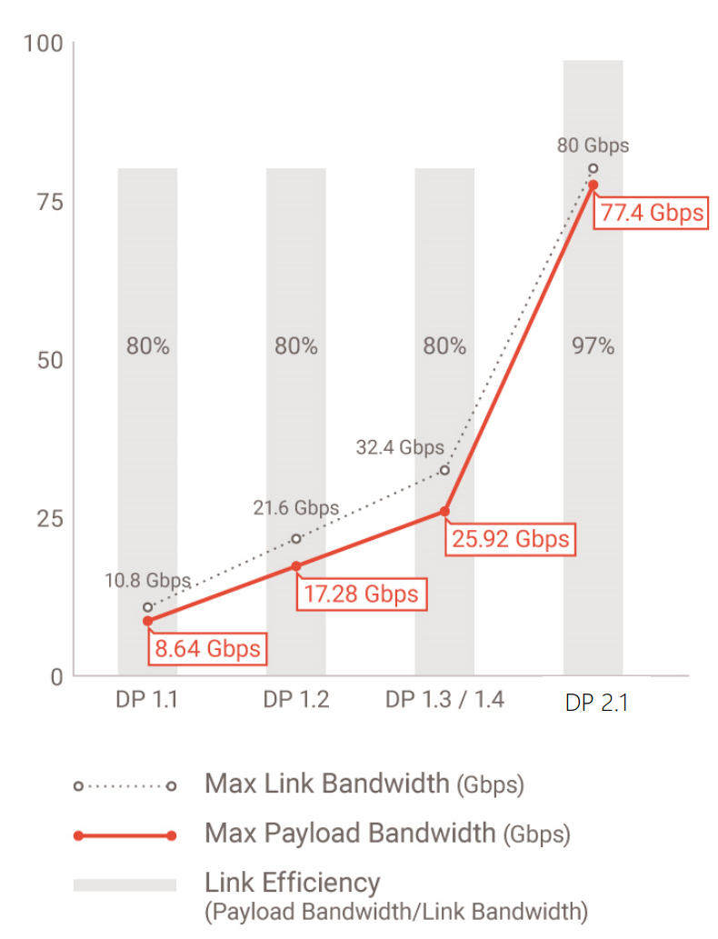
DisplayPort Versions
Technology Refresher
Full Size DisplayPort, Mini DisplayPort, DP Alt Mode
  1.0, 1.1, 1.1a, 1.2, 1.2a, 1.3, 1.4, 1.4a, 2.0, 2.1
Embedded DisplayPort
  1.0, 1.1a, 1.2, 1.3, 1.4, 1.4a, 1.4b, 1.5, 1.5a
Embedded DisplayPort is slightly behind the other DisplayPort standard in terms of data rate
  eDP 1.5a = DP 1.4a for specs
  eDP 1.4a = DP 1.3 for specs
source: vesa.org
Notes:
Long story short there are a lot of versions of displayport, currently we will be focused on 1.4a for Fullsize DP and 1.5a for embedded DP, this is because it is the sweet spot of our oscilloscope bandwidth (the fastest a signal can be is HBR3 aka 8.1 Gbps)

Slide 10
Comparison of DP standards
Technology Refresher
Versions | 1.0 to 1.1a | 1.2 to 1.2a | 1.3 | 1.4 to 1.4a | 2.0 to 2.1
Release Date | May 2006 (1.0) Mar 2007 (1.1) Jan 2008 (1.1a) | Jan 2010 (1.2) May 2012 (1.2a) | Sep 2014 (1.3) | Mar 2016 (1.4) Apr 2018 (1.4a) | Jun 2019 (2.0) Oct 2022 (2.1)
Main Link Transmission Modes:
RBR (1.62 Gbit/s per lane) | Supported
HBR (2.70 Gbit/s per lane) | Supported
HBR2 (5.40 Gbit/s per lane) |  | Supported
HBR3 (8.10 Gbit/s per lane) |  |  | Supported
UHBR 10 (10.0 Gbit/s per lane) | Not Supported |  |  |  | Supported
UHBR 13.5 (13.5 Gbit/s per lane) |  |  |  |  | Supported
UHBR 20 (20.0 Gbit/s per lane) |  |  |  |  | Supported
Number of Lanes | 4
Maximum Total Bandwidth | 10.80 Gbit/s | 21.60 Gbit/s | 32.40 Gbit/s |  | 80.00 Gbit/s
Maximum Total Datarate | 8.64 Gbit/s | 17.28 Gbit/s | 25.92 Gbit/s |  | 77.37 Gbit/s
Encoding Scheme | 8b/10b |  |  |  | 128b/132b
Compression (optional) | n/a |  |  | DSC 1.2 (DP 1.4) DSC 1.2a (DP 1.4a) | DSC 1.2a

Slide 11
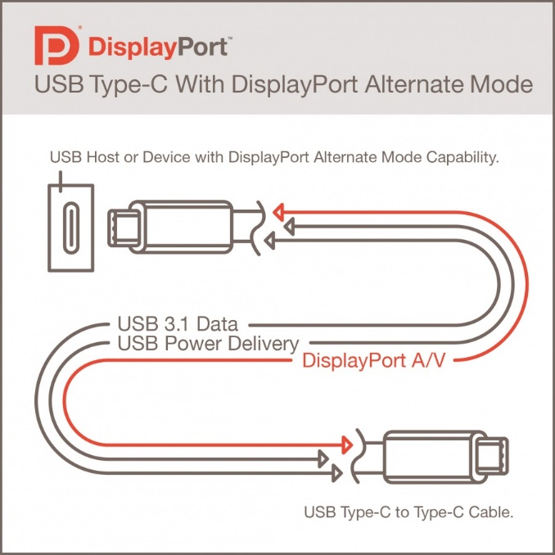
DisplayPort “Alt Mode”
Technology Refresher
DisplayPort on Type-C Connectors by USB Type-C “Alternative Mode”
DP Alt Mode can transmit DP1.4a and DP2.0/2.1 Data Rates
DP Alt Mode may use all four of the Type-C high-speed differential pairs
Source: Vesa.org
Notes:
DisplayPort Alt Mode, using USB-C connectors and cabling, may have the same performance capability as native DP connectors and cabling.
NEWARK, CA (22 September 2014): VESA uses USB Type-C ‘Alternate Mode’ to enable DisplayPort Capabilities over the New, Slim, Reversible USB Type-C Connector
The DisplayPort Alt Mode repurposes some or all of the four existing SuperSpeed USB lanes to deliver full DisplayPort performance, and uses other signaling available in the USB Type-C connector for DisplayPort’s AUX channel and HPD (Hot Plug Detection) function. This enables computers, tablets, smartphones, displays, and docking stations to implement the new USB Type-C connector at both ends while using the DisplayPort Standard over USB Type-C to transmit high-resolution A/V along with USB data and power.
Devices supporting DisplayPort Alt Mode on a USB Type-C connector can also connect to an existing DisplayPort device using a reversible USB Type-C to DisplayPort converter cable.

Slide 12
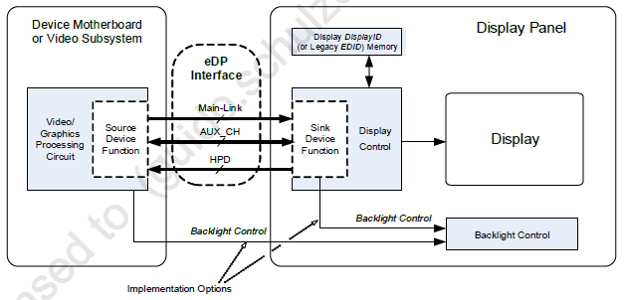
Embedded DisplayPORT (eDP)
Technology Refresher
Standardized set of DisplayPort™ interface features for embedded display application.
  electrical transport for video and auxiliary data between the system host and display panel
  eDP does not mandate universal interoperability between all eDP Source and Sink devices
Typical applications:
  laptops, tablets, smart phones, and
  systems that incorporate its display
  panel with a video or graphics processor
eDP interconnect:
  20- or 30-pin connector: 1- and 2-lane
  40-pin connector will be used for 4-lane
  implementations
Source: eDP Standard v1.5a (Vesa.org)
Notes:
This VESA® Standard defines a standardized set of DisplayPort™ interface features for use in an embedded display application. This embedded interface is referred to as “Embedded DisplayPort” (eDP) and is the electrical transport for video and auxiliary data between the system host (including graphics hardware) and display panel. eDP applications include laptops,
all-in-one PCs, tablets, smart phones, and other systems that incorporate its display panel with a video or graphics processor.
The system integrator determines which cable and connector to use for the eDP interconnect, taking into consideration interconnect requirements such as the number of Main-Link lanes that are needed, signal integrity, EMI performance, mechanical space, cost, etc. Typically, a 20- or 30-pin connector will be used for 1- and 2-lane implementations, and a 40-pin connector will be used for 4-lane implementations
An EPROM will normally be connected to a TCON that contains DisplayID or legacy EDID information for the specific panel configuration. The Source device will then use the eDP AUX_CH to read this data through the eDP interconnect. eDP also includes the provision for using the AUX_CH for display backlight control.
eDP does not mandate universal interoperability between all eDP Source and Sink devices because in an embedded display application, the manufacturer chooses which Source and Sink devices are to be used. For example, eDP feature implementation choices enable trade-offs between system complexity and power consumption.
While no VESA compliance certification test exists for eDP devices, this Standard defines features and levels of performance that eDP Source and Sink devices shall support, as well as those that may be optionally supported, to enable an ecosystem of compatible eDP devices for embedded panel implementations.

Slide 13
Source PHY Compliance Testing

Slide 14
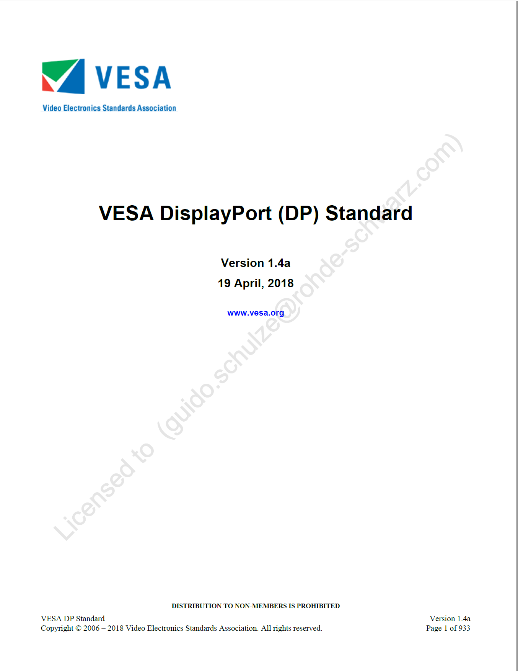
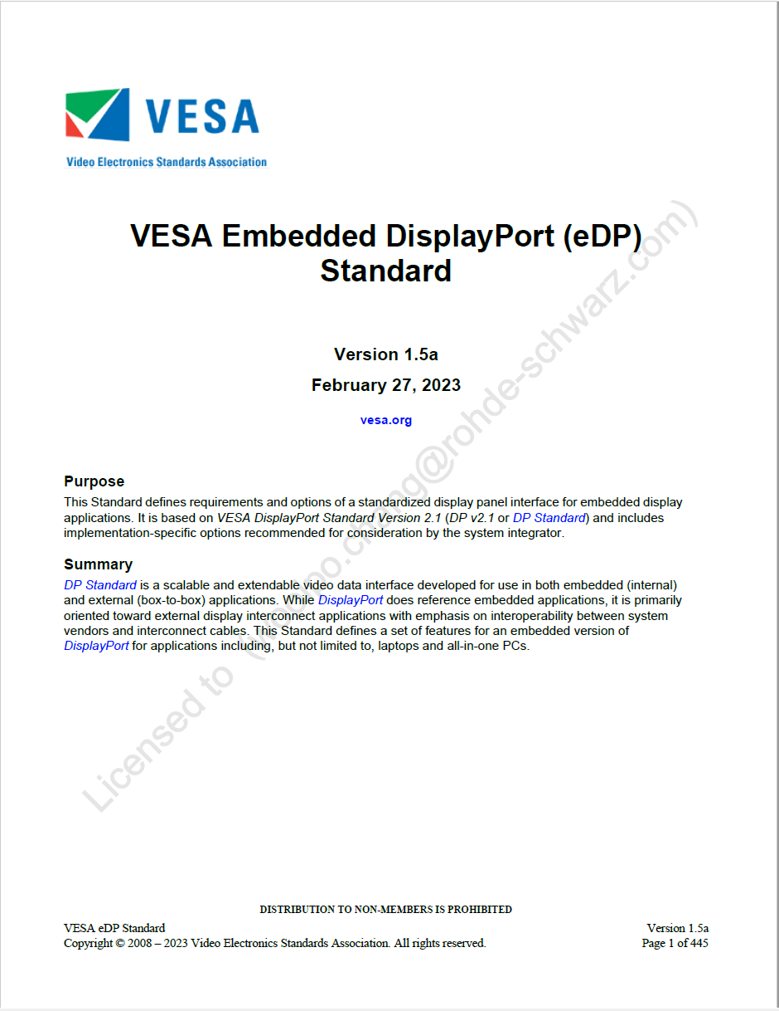
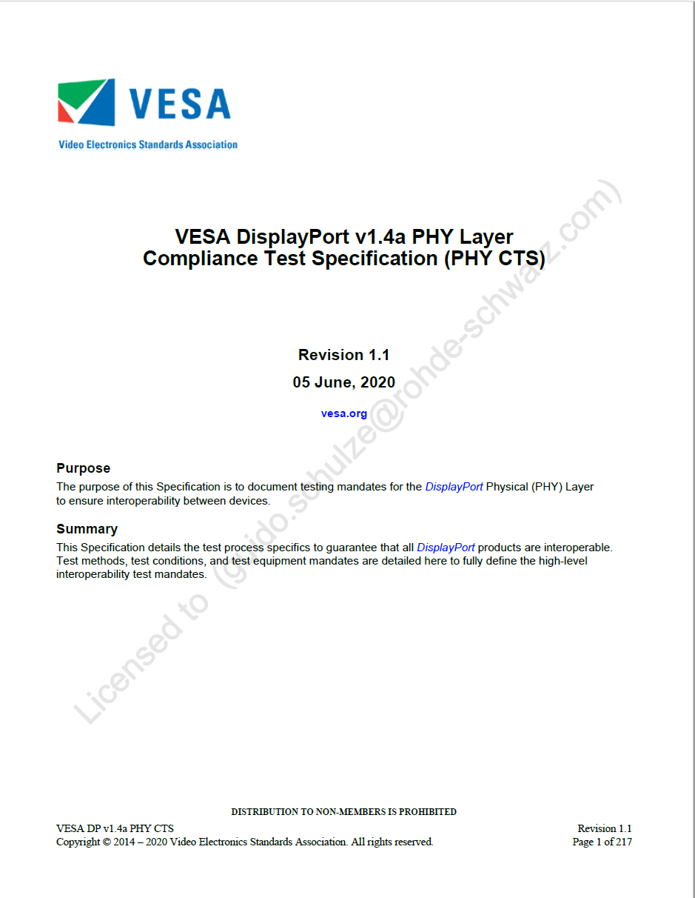
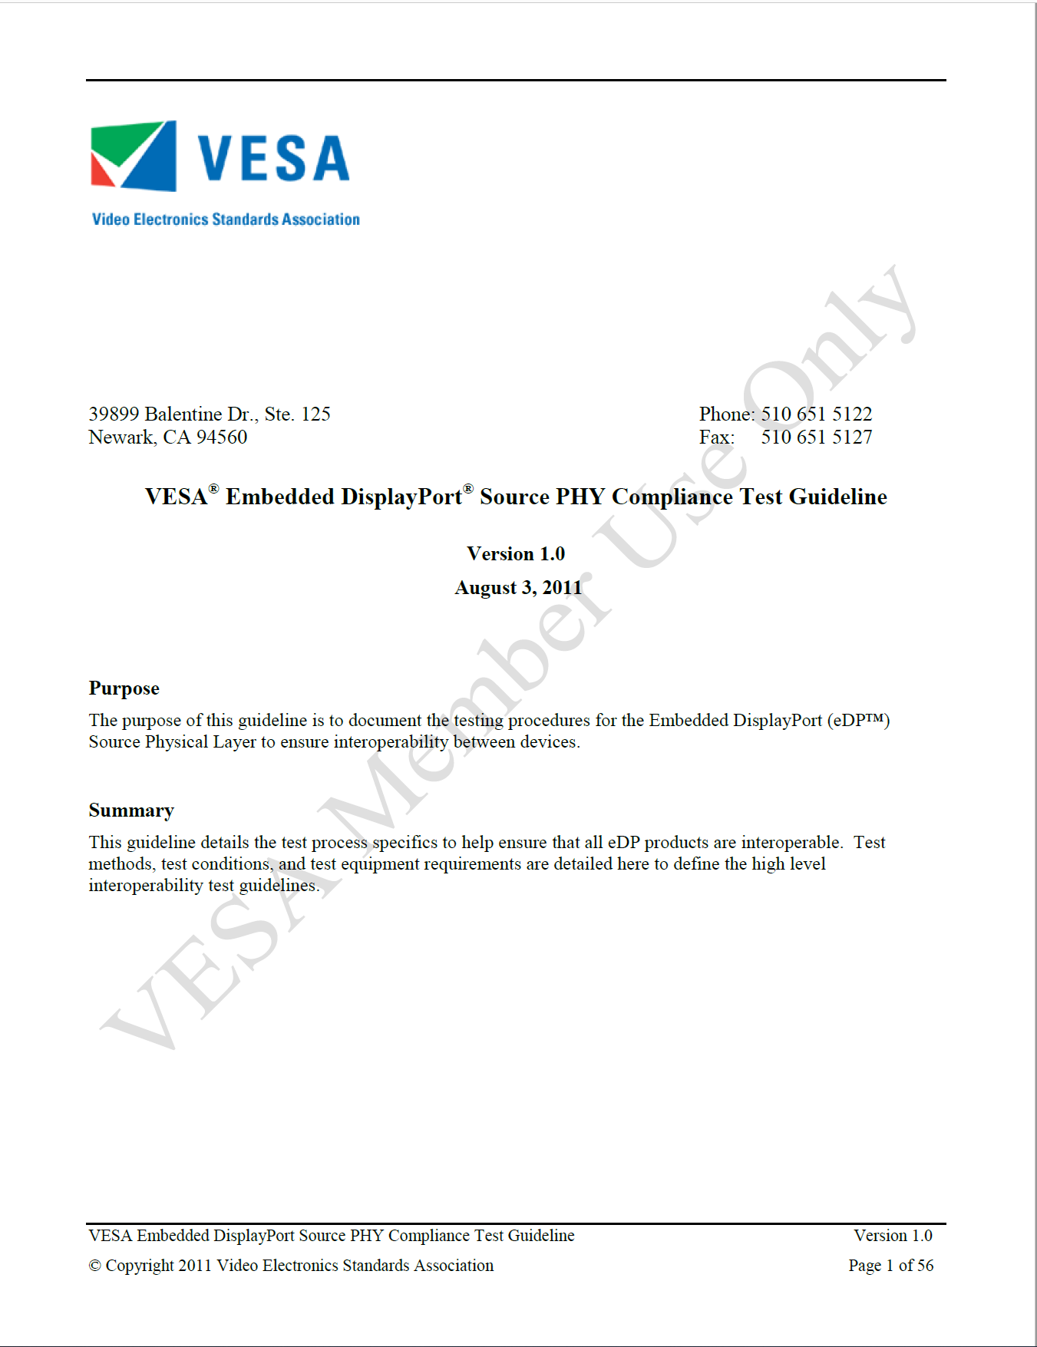
Compliance Test Specifications
Physical Layer: HBR / HBR2 / HBR3
Source PHY Compliance Testing
Related to the DP Standard Versions there exist Compliance Test Specifications for the Physical layer (PHY CTS)
  DP v1.4a Standard / CTS

Slide 15
PHY tests for DP Device Types
PHY CTS 1.4a
Source PHY Compliance Testing
Source devices (section 3):
  Laptop output, graphics card
Sink devices (section 4):
  Monitor
Cable (section 5/6):
  Cables that go from a source to a sink device
Hybrid devices (section 7):
  Branch device like converter, switch or repeater device
Table of Contents of the PHY CTS:
Section 1- Introduction
Section 2- Test Process Mandates
Section 3- DP Source Device Compliance Tests
Section 4- DP Sink Device Compliance Tests
Section 5- DP Passive HBR3 8K Cable Compliance Tests for
DP-to-DP Cables
Section 6- Passive HBR2/HBR/RBR Cable Compliance Tests
Section 7- Hybrid Device Compliance Tests
Section 8- Tethered Devices
Section 9- Common Tests
Appendix A- Compliance EYE Pattern
Appendix B- Main Contributor History
Notes:
Tethered devices: complex devices that are composed of a cable that is permanently attached to either a DP Source or Sink device. These devices are conceived to address specific market mandates and have narrow application. E.g. permanent attachment of a cable to the DP Source device is defined as a tethered DP Source device. The test fixture connected to the cable end is considered to be TP3.

Slide 16
Source tests for DP1.4a & eDP1.5
Source PHY Compliance Testing
3.1 Eye-diagram Testing
3.2 Non Pre-Emphasis Level Verification Testing
3.3 HBR/RBR Pre-Emphasis Level Verification and Maximum Differential Peak-to-Peak Voltage Test
3.4 HBR3/HBR2 Pre-Emphasis Level and Equalization Verification Testing
3.5 HBR3/HBR2 VTX_DIFFP-P_Max Test
3.6 Inter Pair Skew Test (Informative)
3.7 Intra-Pair Skew Test (Informative)
3.8 AC Common Mode Noise Test (Informative)
3.8.1 HBR3 AC Common Mode Noise (Informative)
3.8.2 HBR2/HBR/RBR AC Common Mode Noise (Informative)
3.9 Non ISI Jitter Measurements
3.10 HBR3 TX Differential RL Test (Informative)
3.11 TJ/RJ/DJ Measurement Tests
3.11.1 TJ/DJ Measurement Test
3.11.2 HBR3 TJ/Non-ISI Jitter Measurement Test
3.11.3 HBR2 D10.2 TJ/RJ/DJ Measurement Test
3.12 Main-Link Frequency Compliance Test
3.13 Spread-spectrum Modulation Frequency Test
3.14 Spread-spectrum Modulation Deviation Test
3.15 dF/dT Spread-spectrum Deviation High-frequency Variation Test (Informative)
Notes:
We are not creating tests in our automation software for informative tests now, if you hear customer feedback that we should include those tests we can revisit this topic
Pre-emphasis is

Slide 17
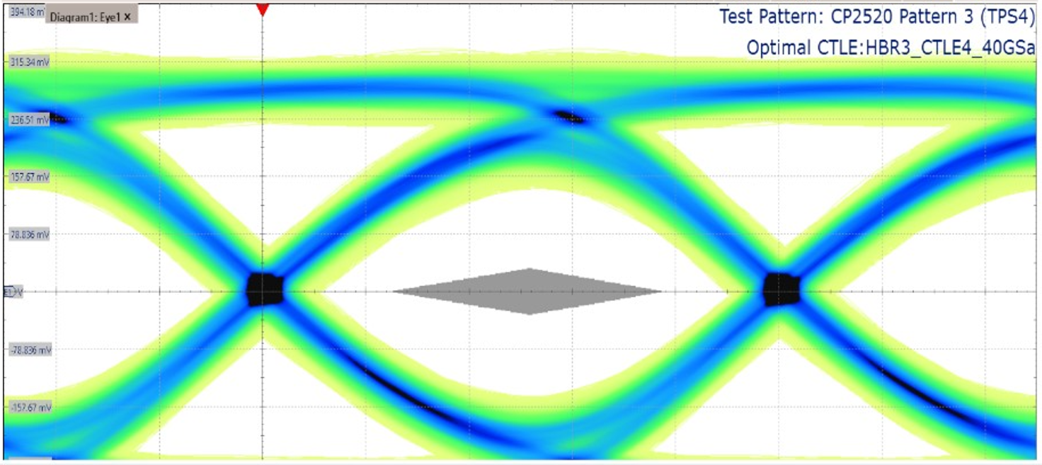
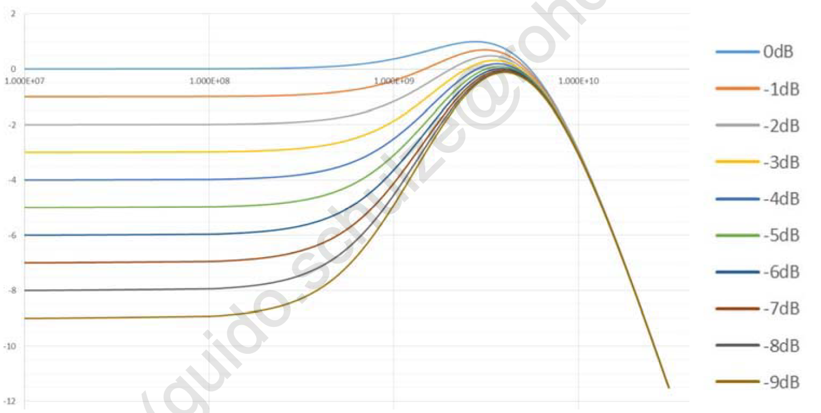
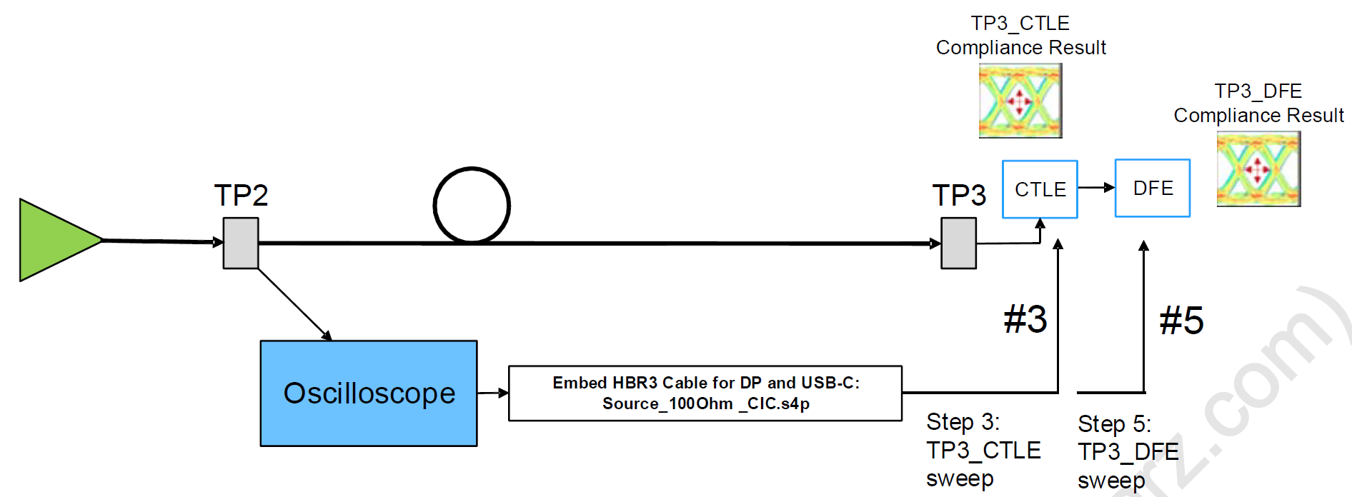
EYE diagram Testing (3.1)
Source PHY Compliance Testing
Visual tool for assessing interoperability
Providing an intuitive understanding of design margin
Test conditions:
  TP2; TP3
  Source’s amplitude and pre-emphasis
  Channel emulations + CTLE / DFE
Test pattern:
  PRBS7 (RBR / HBR)
  TPS4/ CP2520 (HBR2 / HBR3)
Tests:
  Eye mask test verifying
  open eye height and width
Source: DP Standard, Version 1.4a CTS (Vesa.org)
Notes:
The DP Source device’s EYE diagram performance provides the best visual tool for assessing interoperability and showing the signal’s amplitude and timing attributes, thereby providing an intuitive understanding of design margin.
The HBR3 Compliance Test steps are as follows:
1 Capture the waveform at TP2, as illustrated in Figure 3-1.
2 Embed the HBR3 cable model.
3 Calculate TP3_CTLE_Optimal. If TP3_CTLE_Optimal meets the EYE Diagram Pass criteria = Pass.
4 If TP3_CTLE_Optimal does not meet the EYE Diagram Pass criteria, use the VESA DFE tool to calculate TP3_DFE_Optimal.
5 If TP3_DFE_Optimal meets EYE Diagram Pass criteria = Pass, else fail.
CP2520: 252 10-bit words; 3 Pattern versions, starting with different 4 word sequences (Enhanced Framing Control Symbol Sequence). TPS4 is pattern 3, starting with SR-BS-BS-SR-248 00hs (after data symbol scrambling and 8b/10b coding). SR is K28.0; BS is comma character K28.5

Slide 18
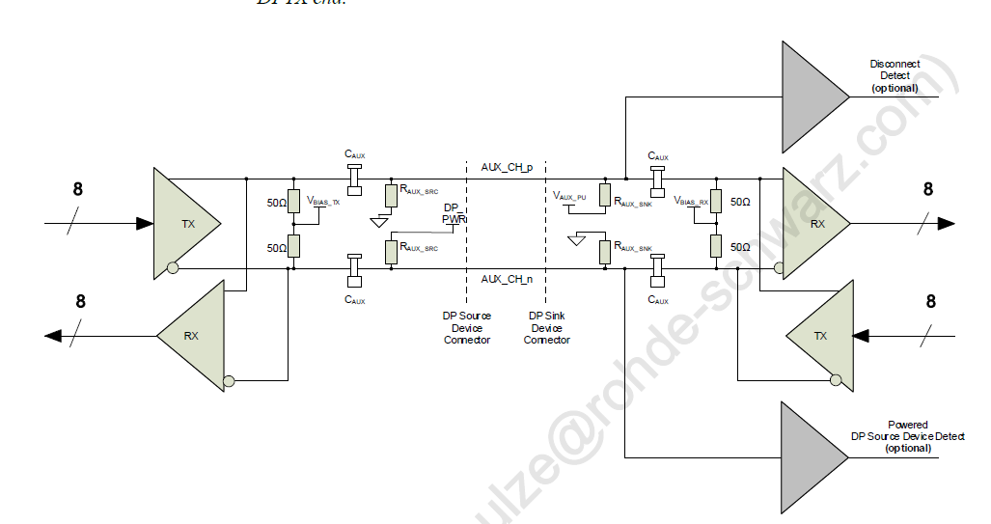
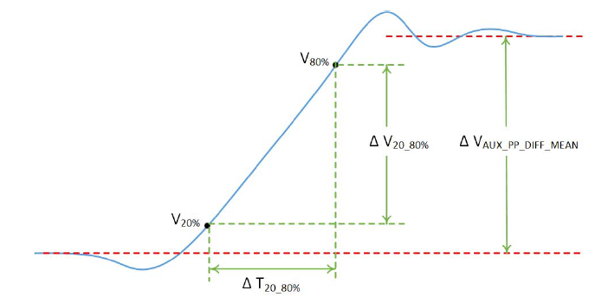
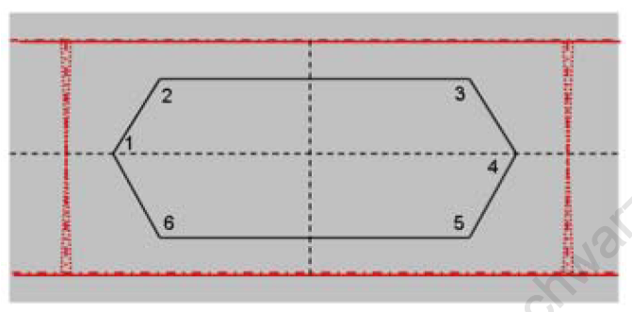
Common Tests for DP1.4a
Source PHY Compliance Testing
Common tests:
9.1 AUX_CH (Manchester-II) Eye Test
9.2 AUX_CH (Machester-II) Sensitivity Test
9.3 AUX_CH_n Termination DC Test
9.4 AUX_CH_p Termination DC Test
9.5 AUX_CH Slew Rate Test
9.6 Inrush (Normative)
and Outrush (Informative) Test
9.7 DP_PWR DC Level Test
9.8 DP_PWR Current Test
Source: DP Standard, Version 1.4a (Vesa.org)
Notes:
1 Mbps, 2 V Manchester coded signal
The AUX_CH is a half-duplex, bidirectional channel consisting of one differential pair, supporting the bit rate of approximately 1Mbps.

Slide 19
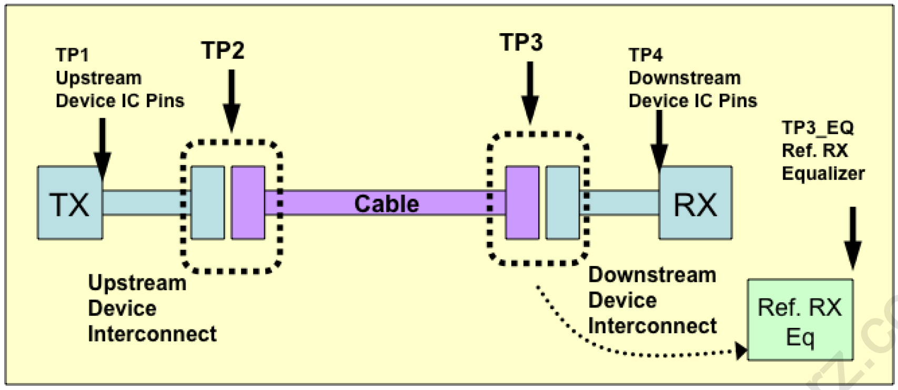
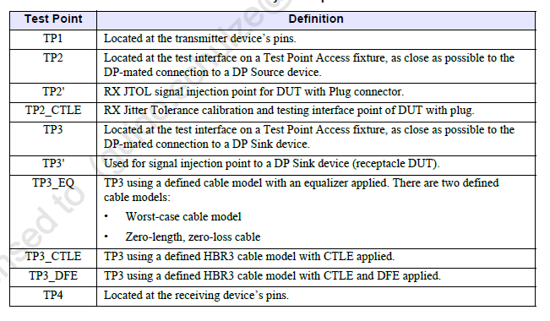
Test Points
Source PHY Compliance Testing
Four test points for DP:
  TP1: At pins of Source device (TX)
  TP2: At Source test fixture
  TP3: At Sink test fixture
  TP3_EQ: TP3 with cable and equalization emulated
  TP4: At pins of Sink device (RX)
Source: DP Standard, Version 1.4a CTS (Vesa.org)

Slide 20
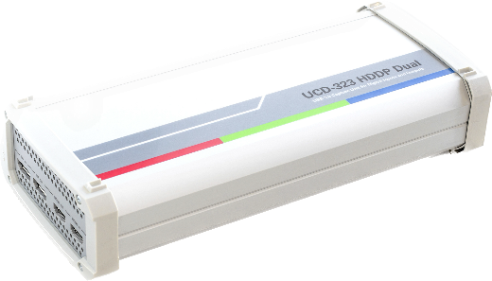
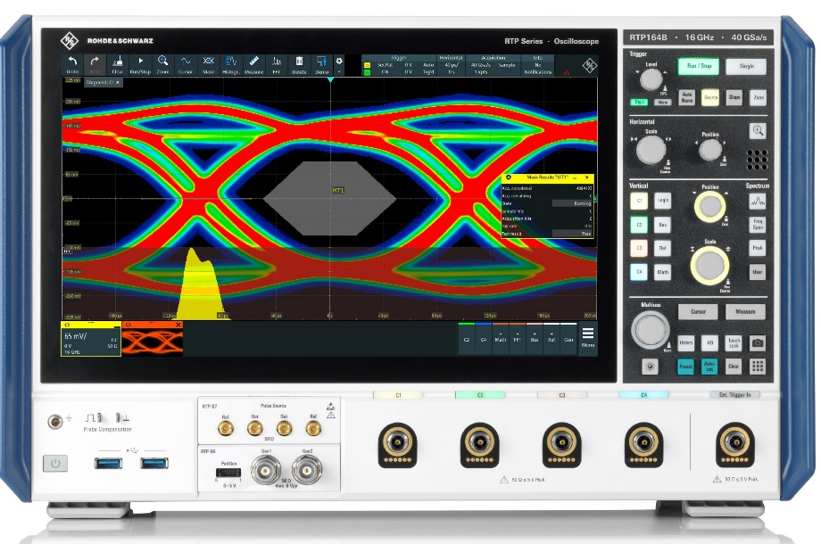

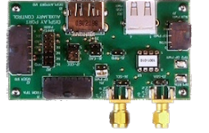
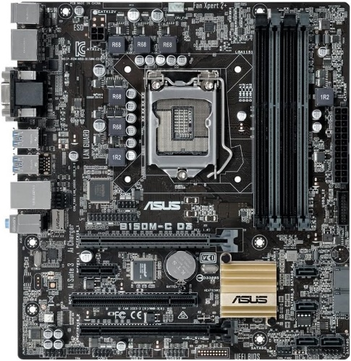
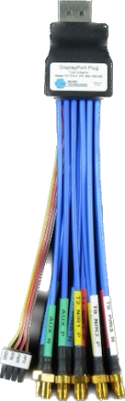
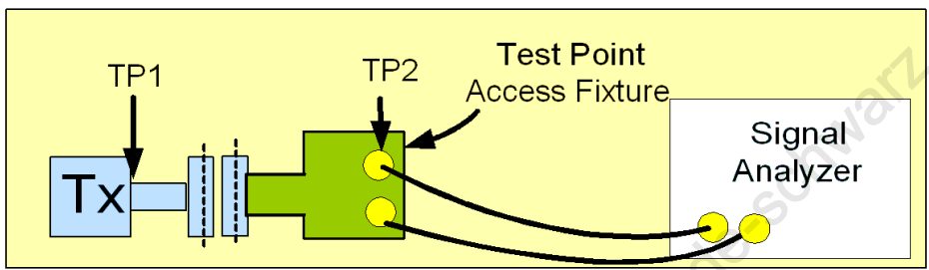
Test Setup
Source PHY Compliance Testing
Aux Emulator
Control PC
Oscilloscope
USB Cable
DP Cable
Aux Breakout Board
DUT
SMA Cables
Test Fixture

Slide 21
Scope Bandwidth
Source PHY Compliance Testing
 | DP Data rates | Scope BW transmitter testing | Scope BW receiver calibration | RTP Model
RBR | 1.62 Gbps | 4.05 GHz |  | RTP044B
HBR | 2.7 Gbps | 6.75 GHz |  | RTP084B
HBR2 | 5.4 Gbps | 12 GHz | 12 GHz | RTP134B
HBR3 | 8.1 Gbps | 12.5 GHz | 16 GHz | RTP134B

Slide 22
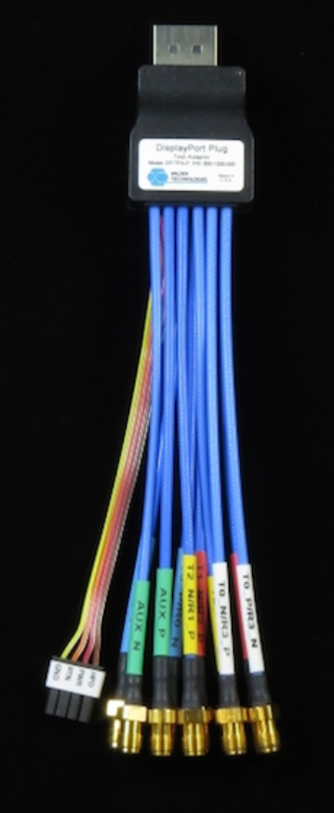
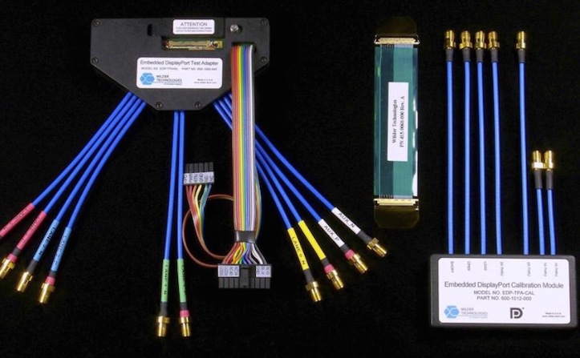
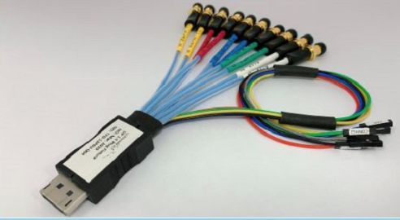
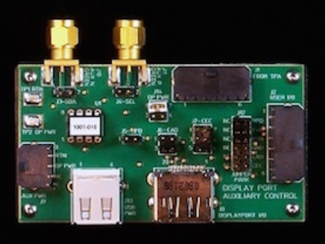
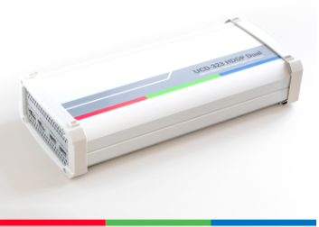
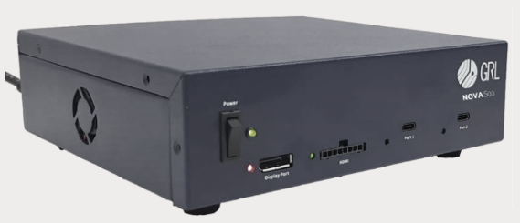
Test Accessories
PHY-Source Compliance Testing
Test fixtures (DP, mDP, USB-C, etc.)
  Wilder Technology
  Luxshare ICT
Emulators:
  Unigraf
  Granite River Labs
Wilder:
DP-TPA-A
Wilder:
DP-TPA-P
Wilder:
EDP40 kit with EDP-TPA40L-R
Luxshare:
TFD-13P6U
Unigraf: UCD-323
GRL: Nova-S03

Slide 23

Typical Test challenges
Source PHY Compliance Testing
Amount of time it takes to complete calibration and the full compliance test manually
Understanding what hardware/software/accessories are required for testing
Configuration of DisplayPort source output mode
Operation of Embedding and Equalization
Compliance test fails – how to to do root cause analysis

Slide 24
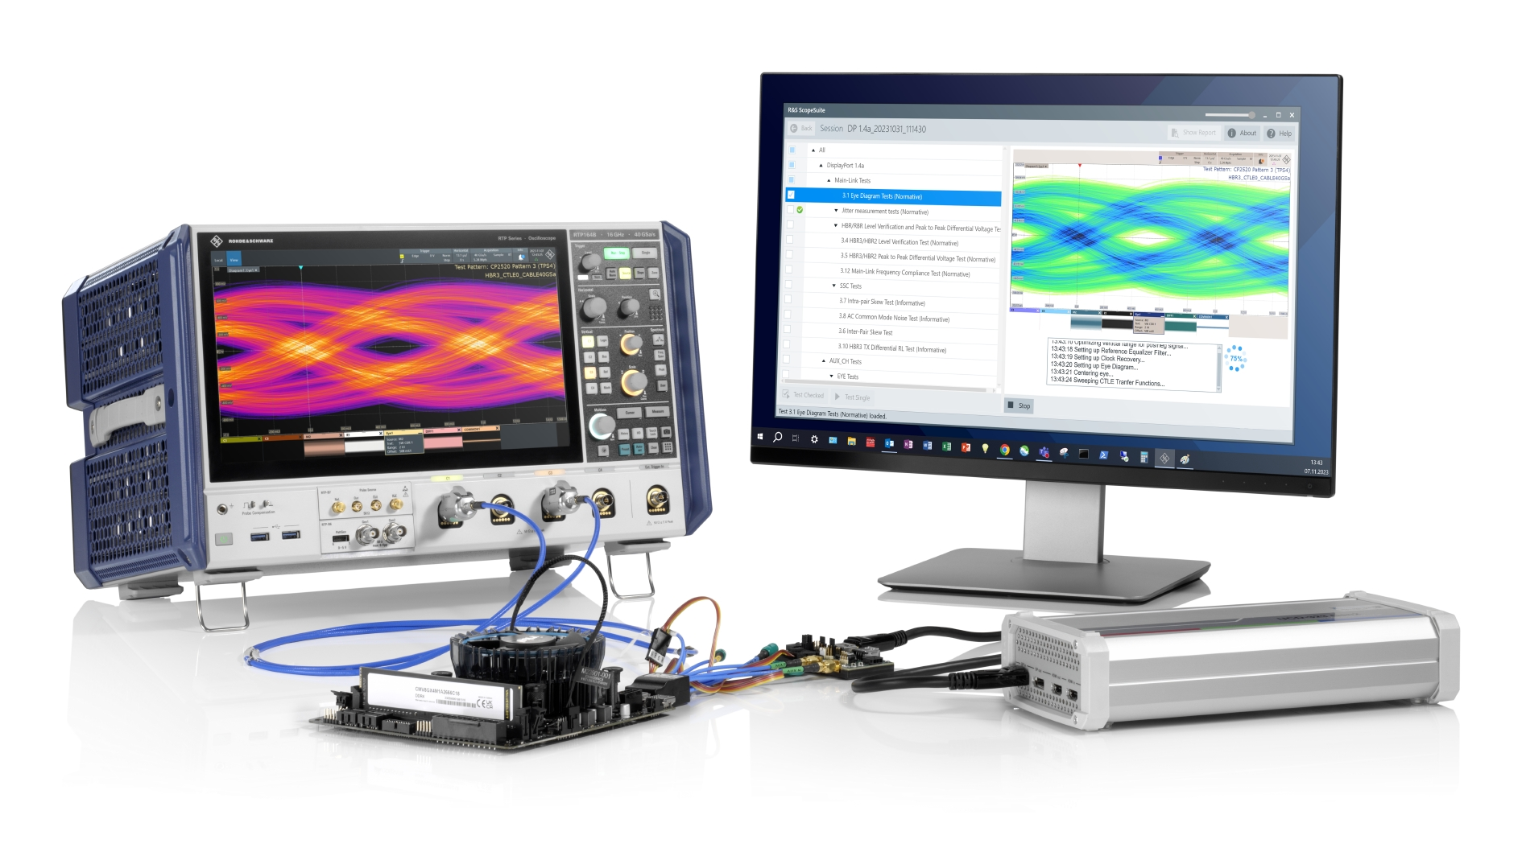
Rohde & Schwarz Test Solution

Slide 25
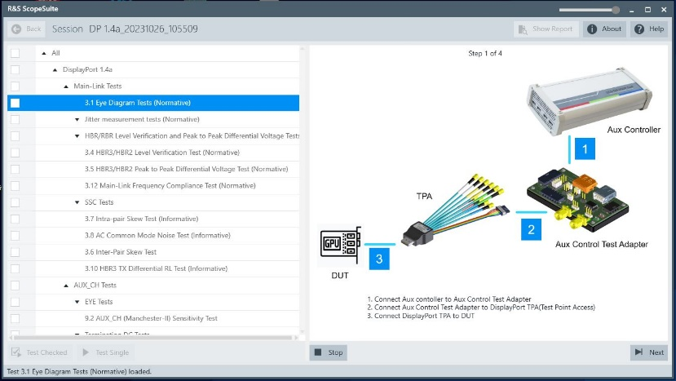
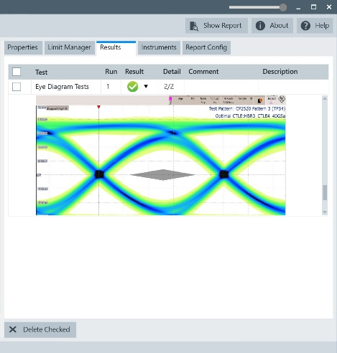
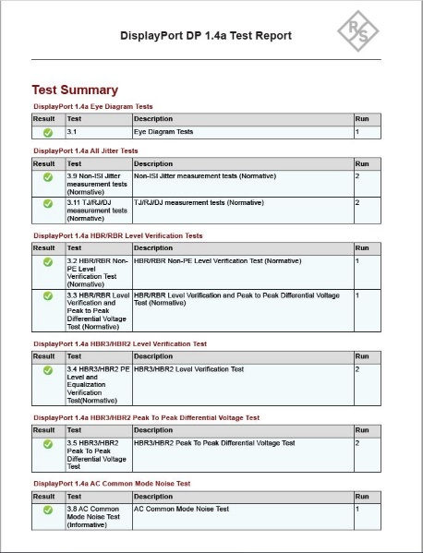
Automated Compliance TEst
R&S Test Solution
Functions:
  Automated transmitter (Tx) test solution
  Step-by-step wizard guidance
  Worst-case cable model embedding and equalization support w/o add. options
  Clear and comprehensive test documentation
Supported modes:
  RBR, HBR, HBR2, HBR3
Options:
  R&S®RTP-K114: DP 1.4a
  R&S®RTP-K115: eDP 1.5
Test fixtures: order from Wilder or Luxshare
Emulator: order from Unigraf or GRL
Notes:
Automated transmitter (Tx) compliance test solution for DP1.4a and eDP 1.4b/1.5
Step-by-step wizard guidance
Worst-case cable model embedding and equalization support
Clear and comprehensive test documentation

Slide 26
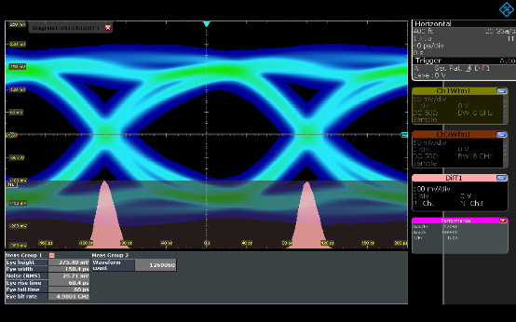
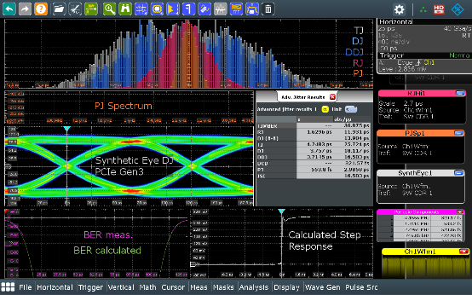
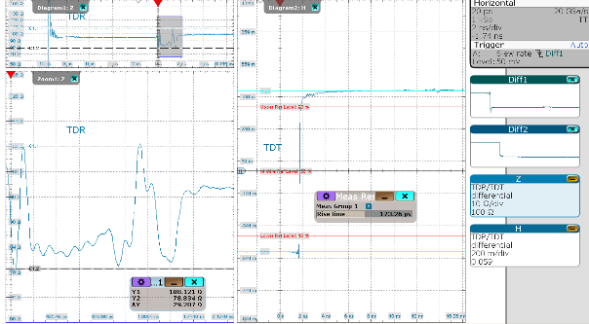
Signal Integrity Debugging
R&S RTP Oscilloscope: Unique Analysis Functions
R&S Test Solution
Fastest
Eye Diagram Analysis
Most detailed Jitter & Noise Decomposition
Most versatile
TDR/TDT Analysis
  HW-CDR based triggering
  Real-time deembedding
  Real-time differential math
  Real-time analysis
  (histogram, mask)
  Histograms for all components
  Track and Spectrum views
  Eye diagram, BER bathtub
  Step/Frequency response
  16 GHz differential Pulse Source
  TDR / TDT Analysis SW
  Guided calibration & measurement
  PacketMicro Probe

Slide 27
Demonstration

Slide 28
Summary

Slide 29
Typical Configuration: DP 1.4a / eDP1.5
Summary
# | Type | Description | DP 1.4a | eDP1.5a
1x | RTP134B | 13 GHz high-performance oscilloscope | x | x
1x | RTP-K114 | DP 1.4a compliance test option | x | -
1x | RTP-K115 | eDP 1.5 compliance test option | - | x
1x | RTP-K137 | Advanced Eye analysis option | x | x
1x | RTP-K141 | Serial Pattern Trigger option | x | -
1x | RT-ZA17 | Matched pair cable | x | x
2x | RT-ZM130 | 13 GHz modular probe w/ RT-ZMA40 (for Inter-Pair-Skew) | x | x
2x | RT-ZS10 | 1 GHz active probes (for AUX_CH testing) | x | x
1x | Test fixture from Wilder or Luxshare (Plug + AUX control adapter) |  | x | x
1x | DP Emulator from Wilder or GRL |  | x | x
Optional – Signal Integrity Debugging
1x | RTP-K134 | Jitter & Noise decomposition option | optional | optional

Slide 30
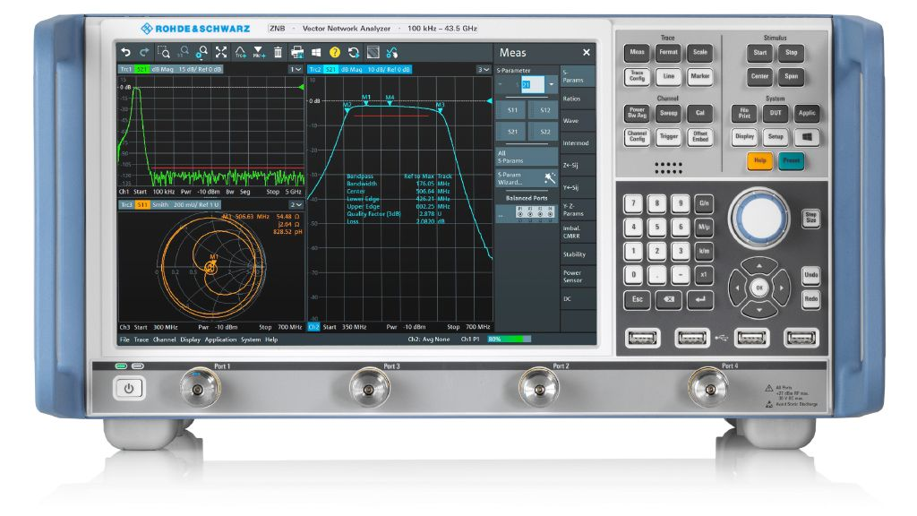
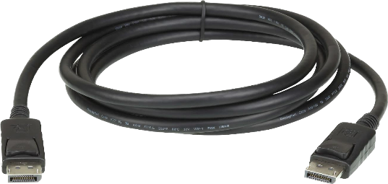
Cable Test
DP 1.4a / 2.0 / 2.1
ZNB26
blabla – Patrick??
DUT
SMA Cables
Fixture
Fixture
Notes:
Cable test setup, pretty simple, there could be a switch matrix used to allow for no manual reconnections, but that is not shown in this cable test setup diagram

Slide 31
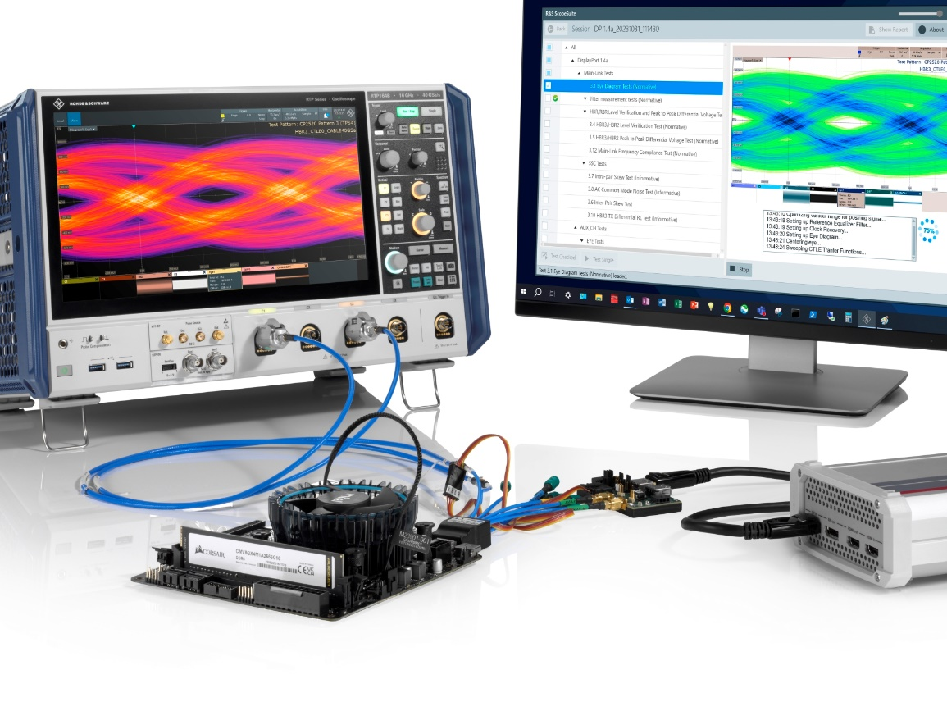
Summary
DP & eDP integration expands to new applications
VESA defines standards & CTS for device interoperability
R&S Source PHY test solutions:
  Signal integrity debugging
  Automated compliance test for
  DP 1.4a and eDP 1.5
Further R&S offering include vector network analyzer for cable testing
Notes:
R&S RTP oscilloscope – most flexible test solution

Slide 32
Thank you!

Slide 33
Notes from Aes during question portion
Need a demo setup with cameras and detailed overview of what is going on there as well as a discussion of the cable test solution
Need customer facing one pager
One pager for each technology (HDMI, USB, DP)
TDR limit lines for eDP/HDMI/DP TDR solution, can we provide this?

Slide 34
Additional Resources
Compliance Test Specification for DP1.4a (link)
List of Certified DP Components, these companies could be our customers!
One pager for AMs focused on ScopeSuite solutions
Scope configuration overview
What other documents do YOU think would be helpful to AMs/SEs/AEs and customers?

